Slide 1
Generating noisy speech data from clean data in the frequency domain using Deep Learning Methods
Week – 17
Name: Shashank Shirol
University: Manipal Institute of Technology
Duration of the presentation: ~10 mins.

Slide 2
Tasks to be completed:
Make quality-of-life modifications to the CUT code to make it more cogent and easy to understand.
Test impact of the speaker in learning a mapping from clean to noisy speech audio files.
Under this, we test how CUT fares when domain A samples are from clean “female” speech audio and domain B samples are from noisy “male” speech audio.
Train CUT with different channels from the RATS corpus.
Under this, tried to train CUT with channel H from the RATS corpus.
Studied the results and tuned CUT code to perform better.
Test how CUT deals when we have unconventional noise in domain B samples
Under this, we use data from Noizeus: A noisy speech corpus for evaluation of speech enhancement algorithms
We test the performance of CUT with two different types of noises – Train and Babble.

Slide 3
QoL modifications to CUT code
Since CUT was developed to perform unpaired image-to-image translation, the code used to initialize data and feed it to the network was set-up in such a way that it required two sets of data even when we were testing the model (using only domain A data for generation).
In other words, during the generation process, we still needed to setup files for both domains even though we only needed domain A (“from” files).
Made quality-of-life modifications such that the model identifies “Test” state and prevents trying to initialize data for both domains.
This allowed us to:
Increase the speed with which we were able to feed CUT with relevant data.
Made the execution more logical, requiring only one set of audio files – clean audio, during the testing phase of execution.

Slide 4
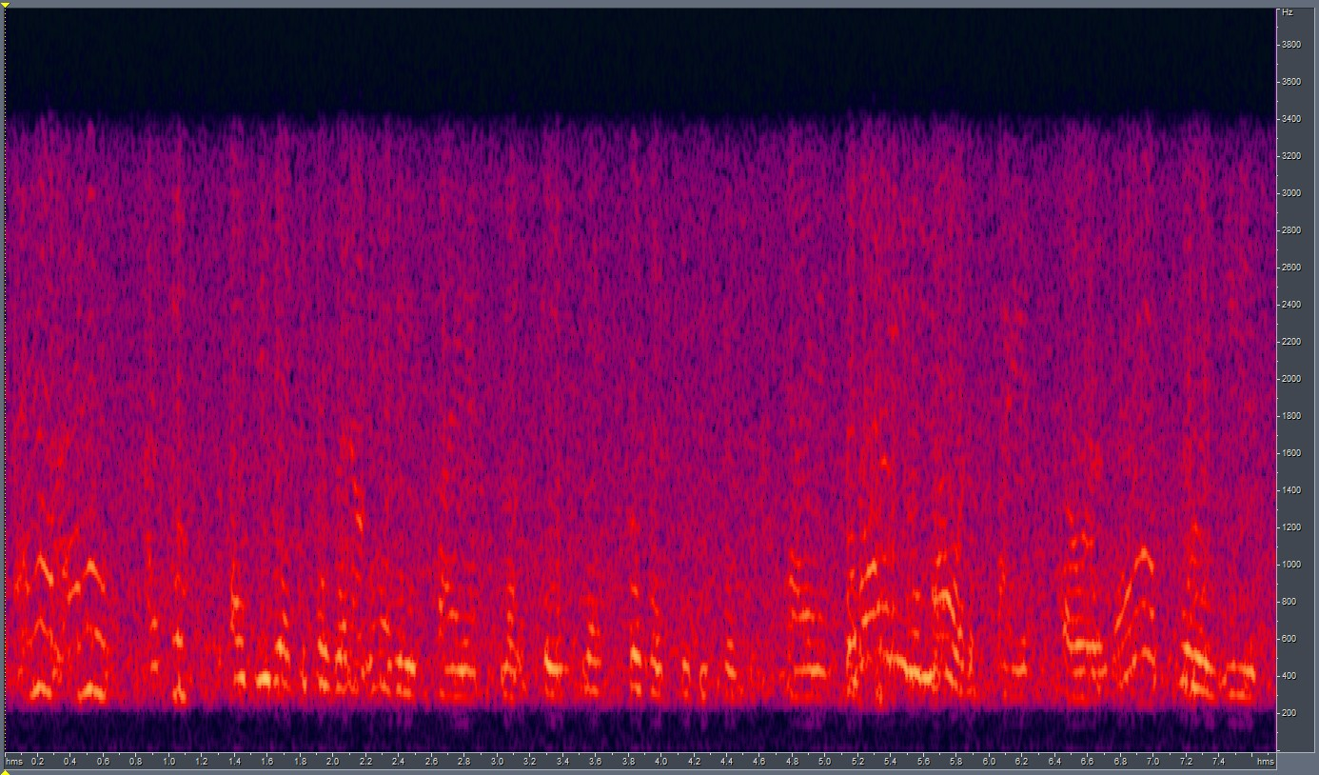
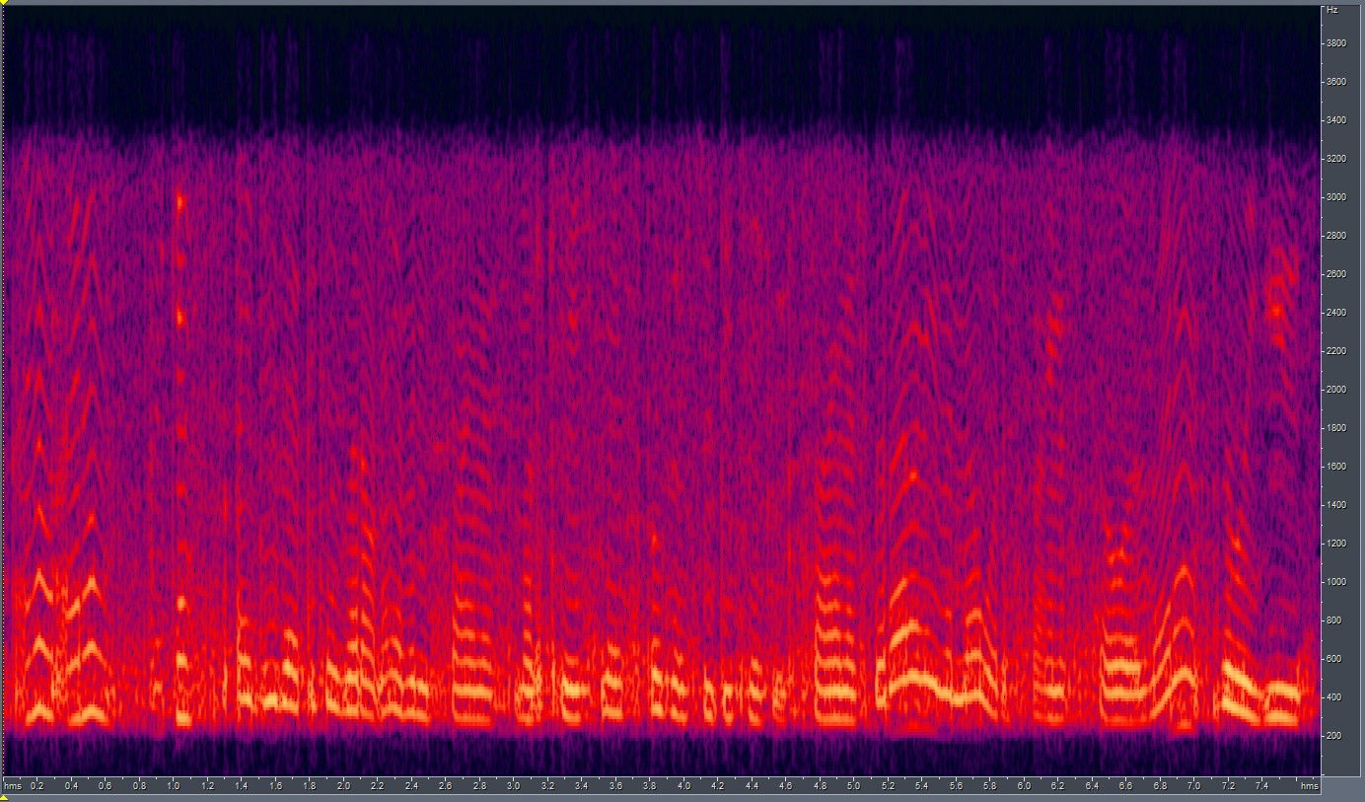

Speaker impact on learning a mapping from clean → noisy speech
Here, we tested if CUT is invariant to the genders of the speakers in the training data.
Under this, we devise the following experimental setup:
Domain A (clean files) – Female
Domain B (noisy files) – Male
Results:
We notice that CUT stayed invariant to speaker in the training data. The results did not vary and we computed a LSD score in the range seen before.
LSD = 6.7808
GT
CUT o/p

Slide 5
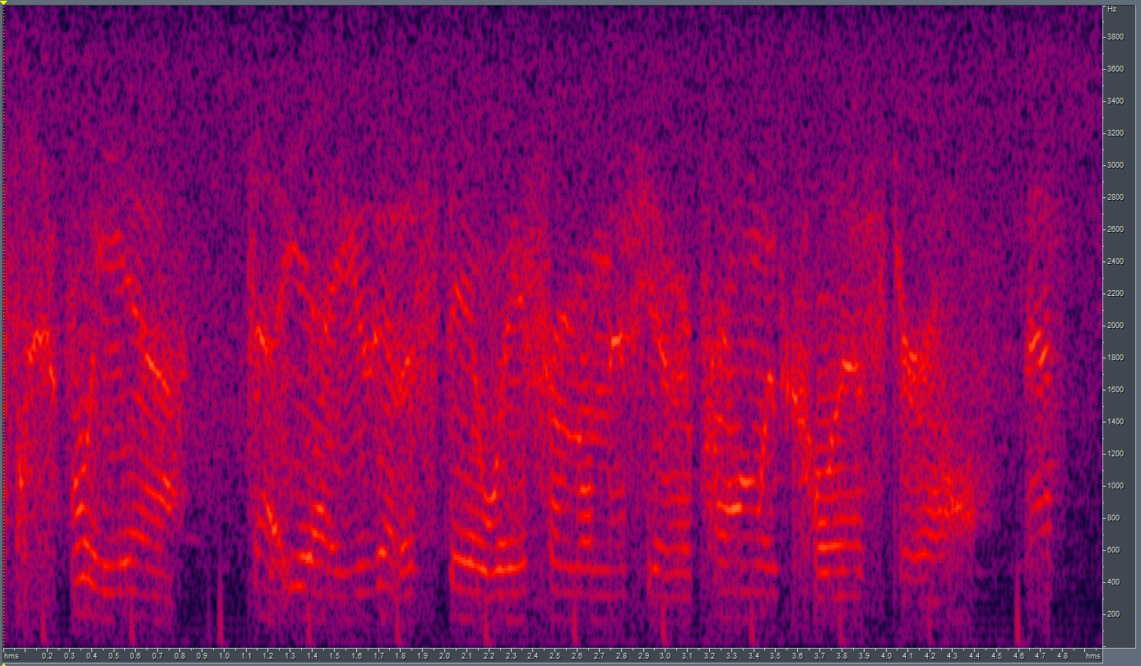
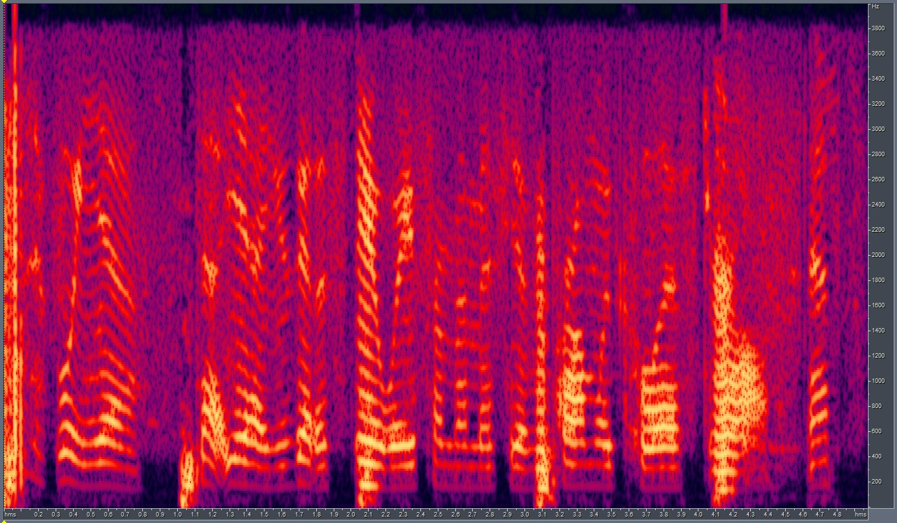
Training CUT with different channels from the RATS corpus: (I)
Here, we tried to train CUT with different channels from the RATs Corpus. To begin with, we chose channel H since it had the most distinct noisy characteristics that could be heard easily.
We faced a problem here, CUT in its first run, failed to successfully learn a mapping, and produced the following results:
Channel H noisy sample
LSD = 10.0226
GT
CUT o/p

Slide 6
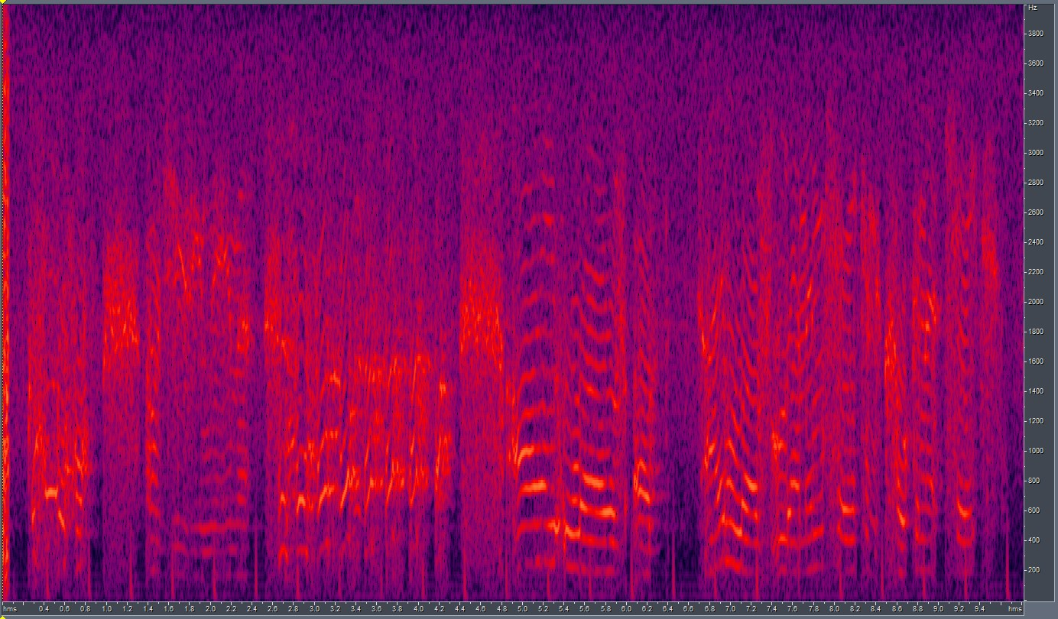
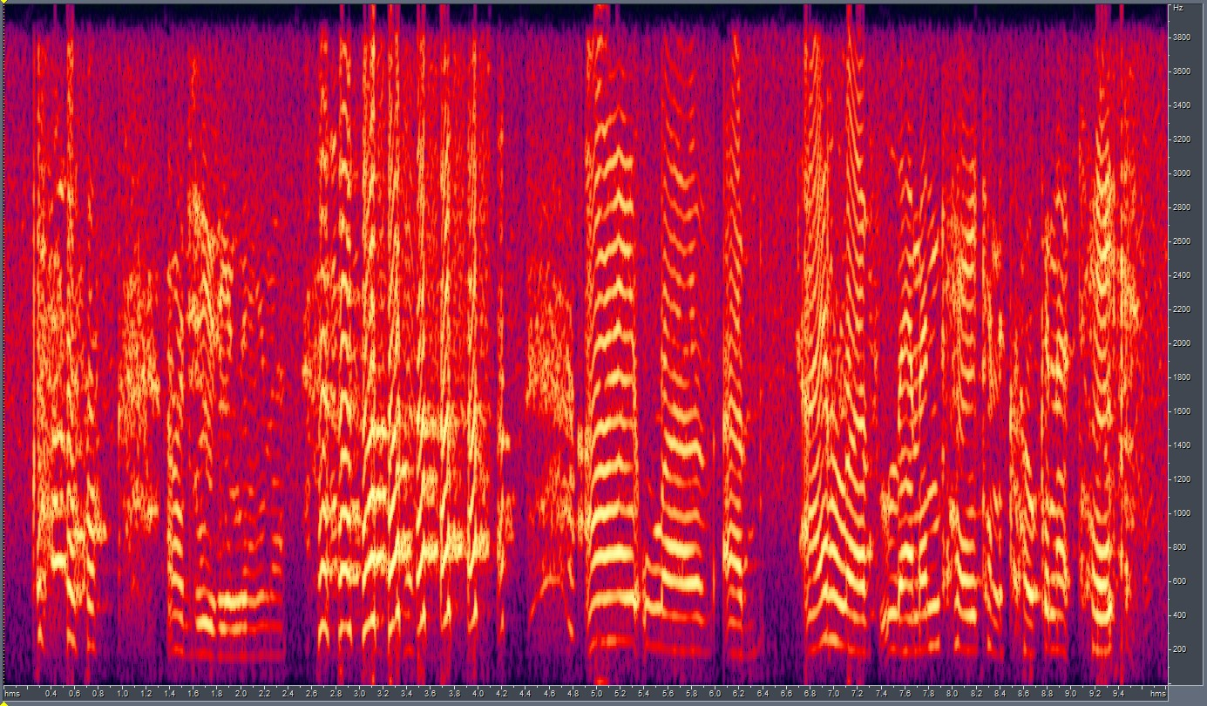
Training CUT with different channels from the RATS corpus: (II)
In an attempt to understand where the problem lied, we develop two experimental set-ups:
Parallel Training – An unpaired set might learn a wrong mapping.
Fix-Norm Training – Variation in the loudness values in the audio files in channel H data might affect the training process.
Parallel Training:
Here we took parallel samples from channel H data of the RATS corpus and trained CUT.
Results:
LSD = 8.4473
GT
CUT o/p

Slide 7
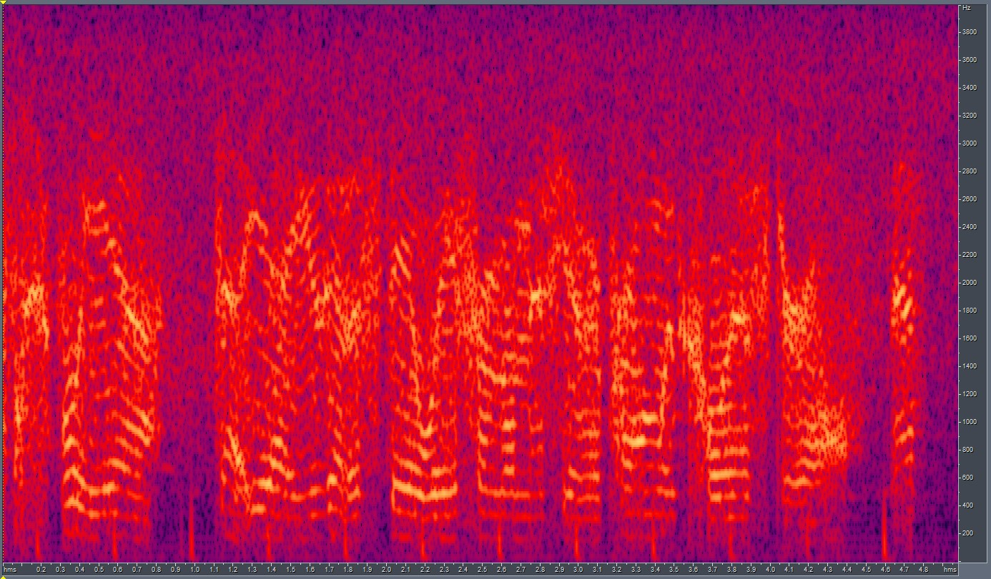
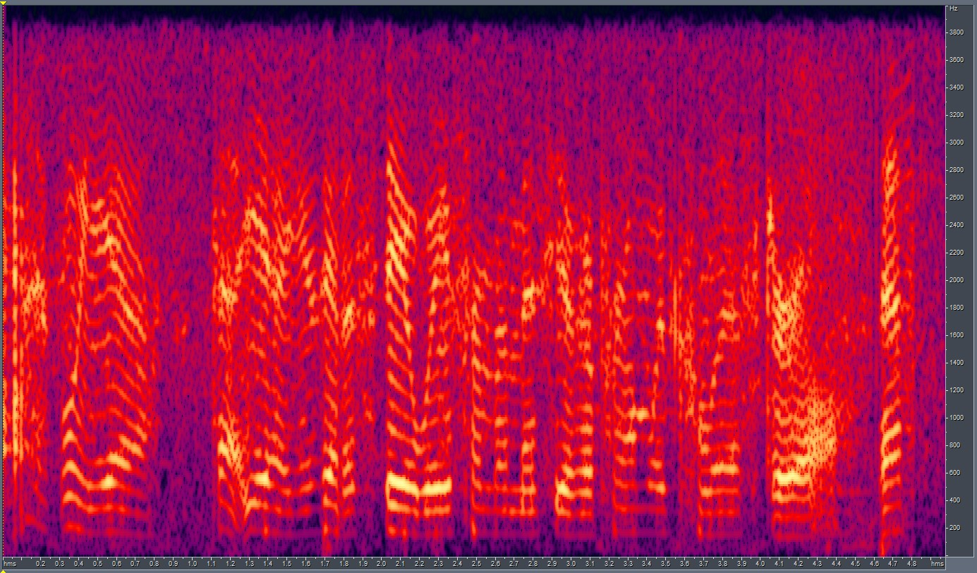
Training CUT with different channels from the RATS corpus: (III)
The difference in the energy levels of the ground-truth and the generated output leads us to the next solution/experiment: Fix-Normalization.
Fix-Norm Training:
Here, before generating the spectrograms and feeding them to CUT, we normalize the audio files to a fixed LUFS (Loudness Unit Full Scale) value.
We find that -23.0 is an industry standard when it comes to normalization. We use that value for our experiment.
Results:
LSD = 7.3850
GT
CUT o/p

Slide 8
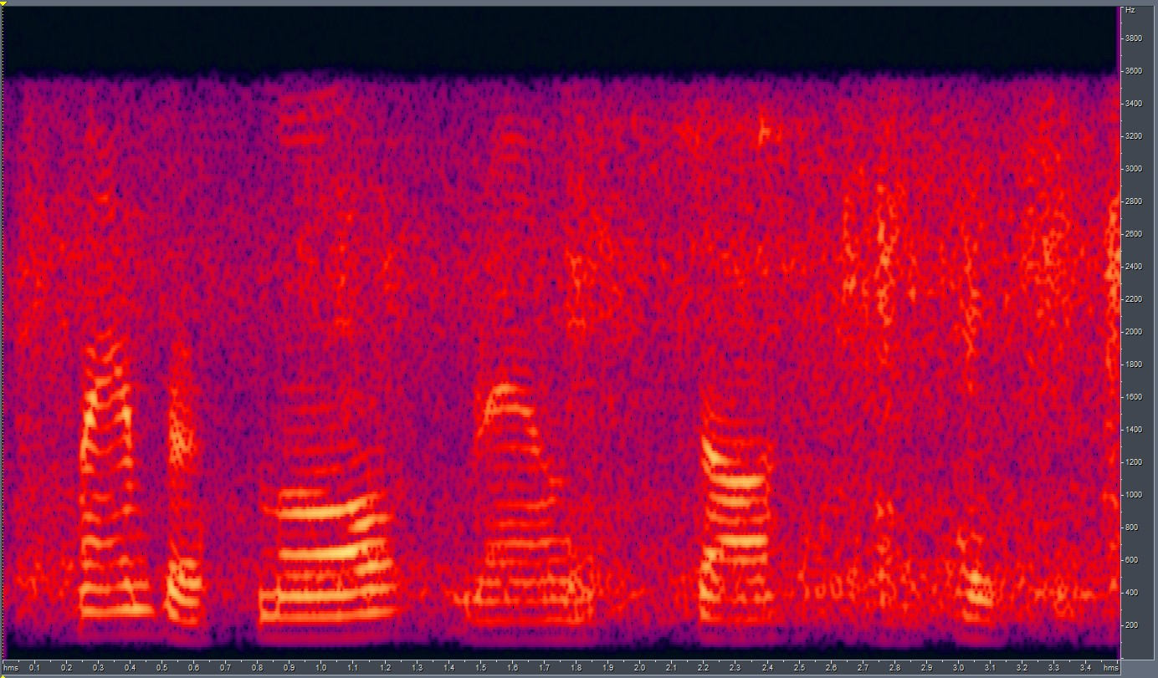
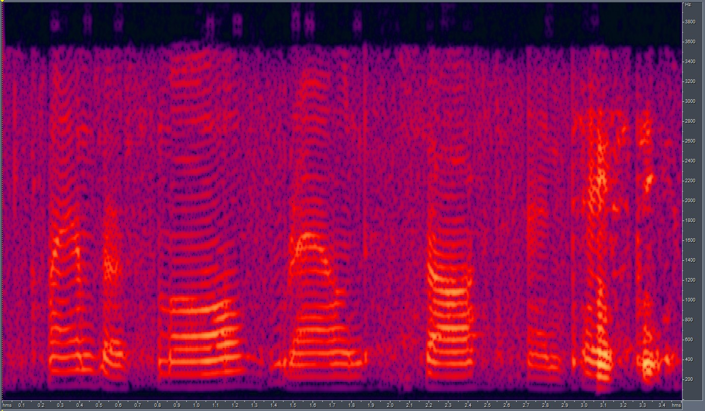
Test CUT against presence of background noise: (I)
Here, we train CUT to learn a mapping from clean to noisy audio speech, where the noisy speech has background noise instead of traditional noise.
We use data from the Noizeus [1] Corpus – Noise from a moving Train, Noise from babble.
Moving Train:
We train CUT with 10 unpaired files (making up about 22 independent samples)
Results:
GT
LSD = 8.0733
CUT o/p
[1] https://ecs.utdallas.edu/loizou/speech/noizeus/

Slide 9
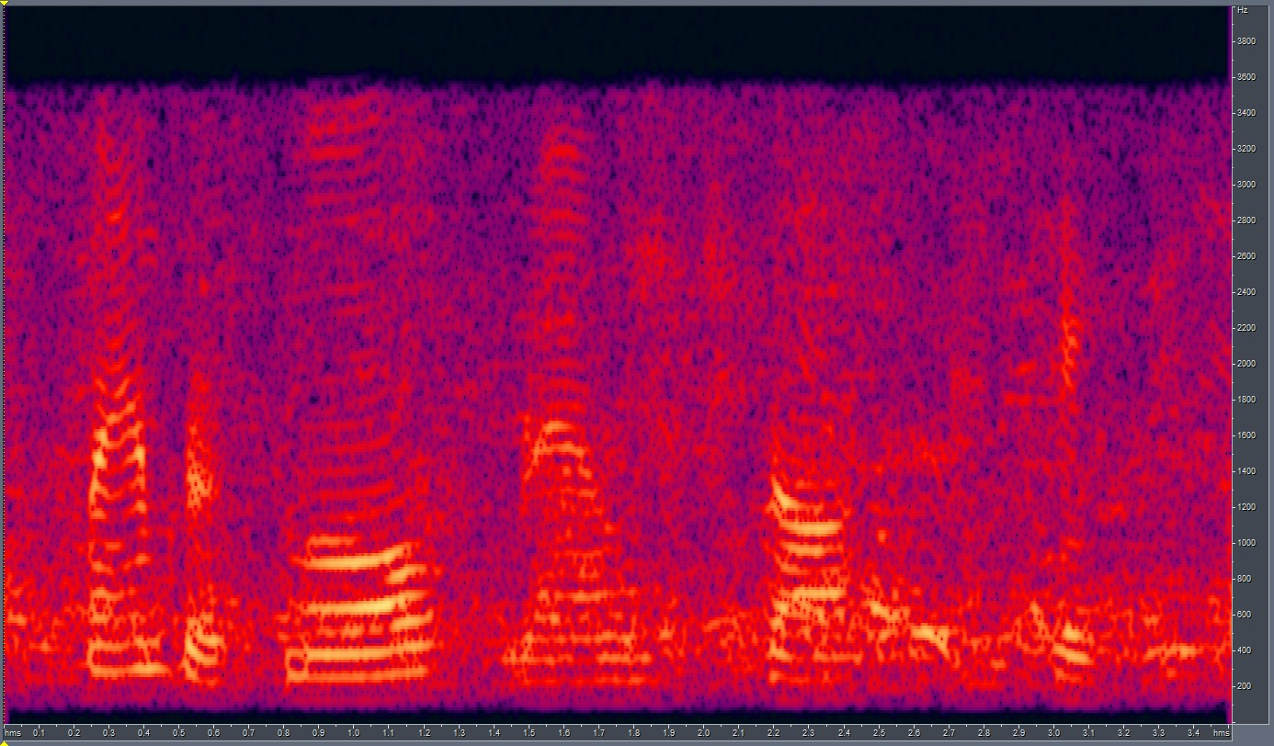
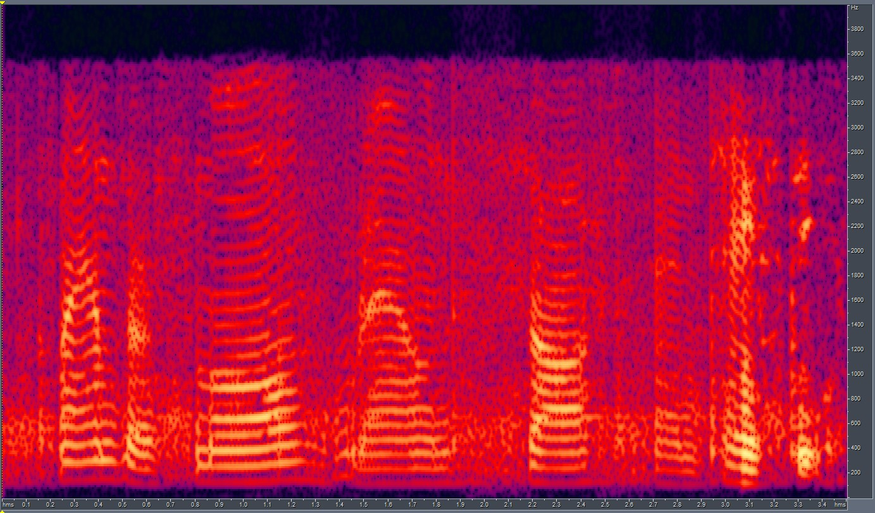
Test CUT against presence of background noise: (II)
Babble Noise:
We train CUT with 10 unpaired files (making up about 22 independent samples)
Results:
GT
CUT o/p
LSD = 7.3902

Slide 10
End.

